Slide 1
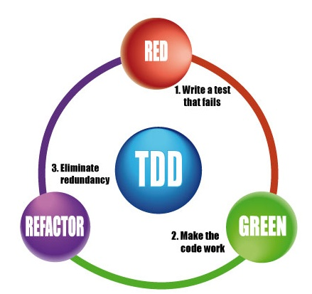
Software Engineering #22916 , Project by Ben Zagagy (300924859)
This Project is an investigation project for the JASMINE TDD framework.
It contains:
documentation on Jasmine's TDDs solution and its SE Practices
Backlog Creation
Investigation & Demo Project
Helping the JASMINE Project by trying to fix exiting issues
The Project’s Github repository can be found at:
https://github.com/Openu22916/CalculatorJasmine
Project Overview
Introduction and motivation
Planning
Execution (Development)
Results
Conclusions

Slide 2
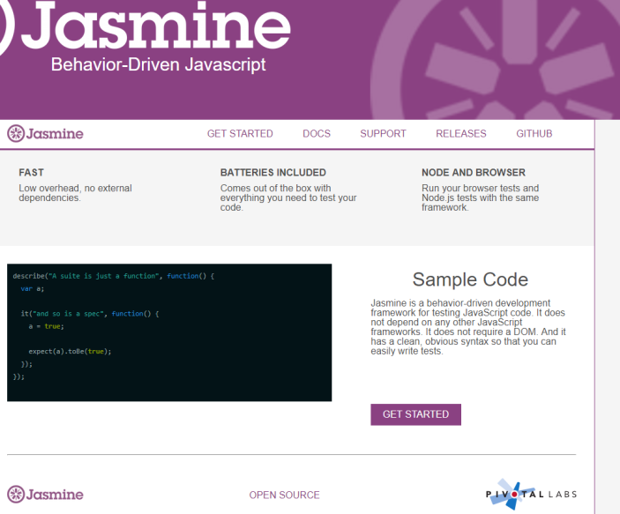
Software Engineering #22916 , Project by Ben Zagagy (300924859)
Jasmine is an open source JavaScript Testing Framework.
Jasmine is a Behavior Driven Development testing framework for JavaScript.
Jasmine is a self-contained framework (no dependencies)
Jasmine aims to run on any JavaScript-enabled platform, to not intrude on the application nor the IDE
Jasmine has an easy-to-read syntax.
Jasmine's Documentation & guides can be found at:
http://jasmine.github.io
✔
Project Overview
Introduction and motivation
Planning
Execution (Development)
Results
Conclusions

Slide 3
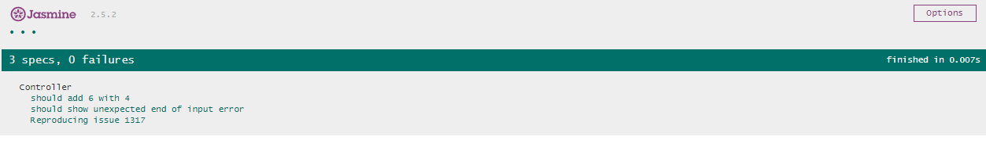
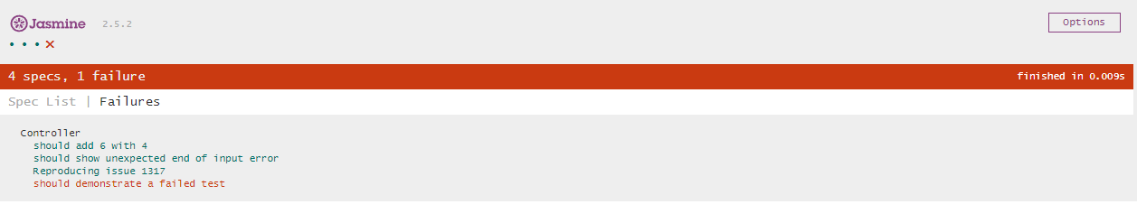
Software Engineering #22916 , Project by Ben Zagagy (300924859)
Jasmine can execute tests locally or following a successful build using a Continues-integration proccess
Jasmine UI is pretty simple as can be sown bellow:
✔
Project Overview
Introduction and motivation
Planning
Execution (Development)
Results
Conclusions
Specs(Unitests) description is show in either:
Green - if the test passed
Red – if the test failed

Slide 4
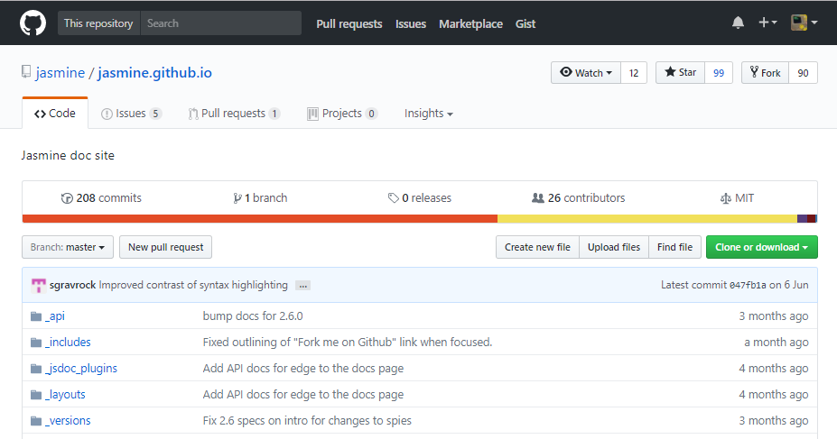
Software Engineering #22916 , Project by Ben Zagagy (300924859)
I have used and Jasmine during my work as senior full-stack developer at TRACXPOiNT , I was lucky enough to embed it in our frameworks a few months back.
My experience with this testing framework thought me that it is a very useful, easy-to-use and intuitive.
Contributing and influencing such an important and useful framework will be a great honor for me as a developer.
✔
Project Overview
Introduction and motivation
Planning
Execution (Development)
Results
Conclusions

Slide 5

Software Engineering #22916 , Project by Ben Zagagy (300924859)
Planning:
Create a backlog with all of the US and tasks for the project
Divide the Backlog into two sprints
Sprint #1 should contain tasks that will be done within the scope of this project
Sprint #2 should contain tasks that aren’t within the scope of this project
✔
Project Overview
Introduction and motivation
Planning
Execution (Development)
Results
Conclusions
✔

Slide 6
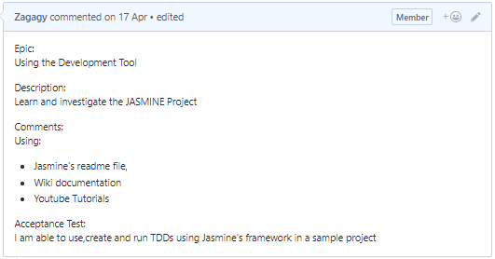
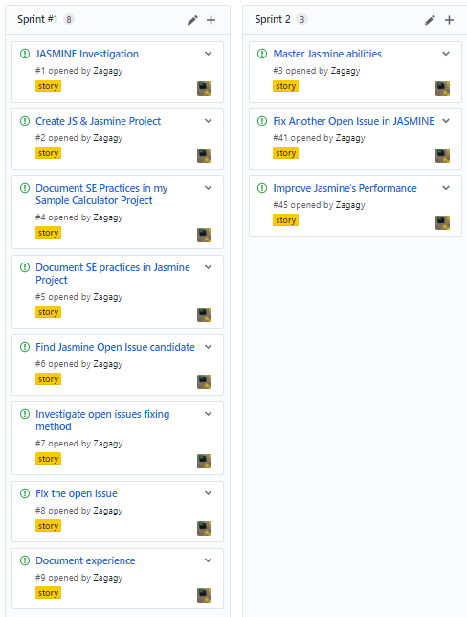
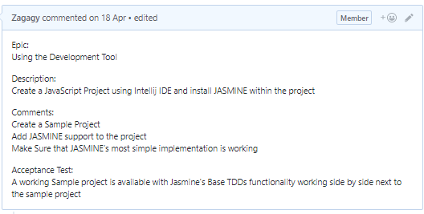
Software Engineering #22916 , Project by Ben Zagagy (300924859)
Sprint #1 Content:
1. Jasmine Investigation
2. Create JS & Jasmine Project
✔
Project Overview
Introduction and motivation
Planning
Execution (Development)
Results
Conclusions
✔

Slide 7
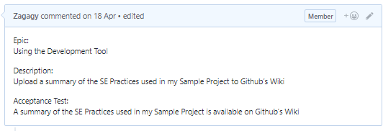
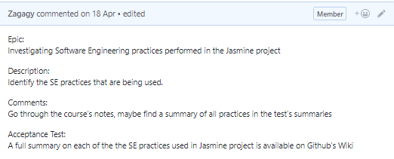
Software Engineering #22916 , Project by Ben Zagagy (300924859)
Sprint #1 Content:
3. Document SE Practices in my Sample Calculator Project
4. Document SE practices in Jasmine Project
✔
Project Overview
Introduction and motivation
Planning
Execution (Development)
Results
Conclusions
✔

Slide 8
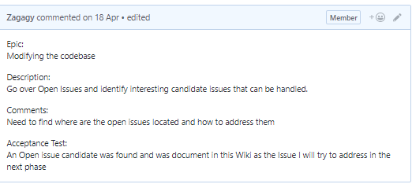
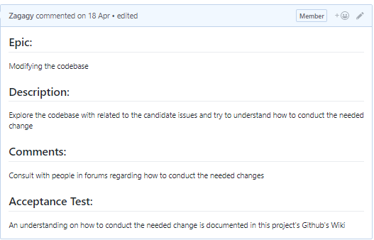
Software Engineering #22916 , Project by Ben Zagagy (300924859)
Sprint #1 Content:
5. Find Jasmine Open Issue candidate
6. Investigate the open issue’s fixing method
✔
Project Overview
Introduction and motivation
Planning
Execution (Development)
Results
Conclusions
✔

Slide 9
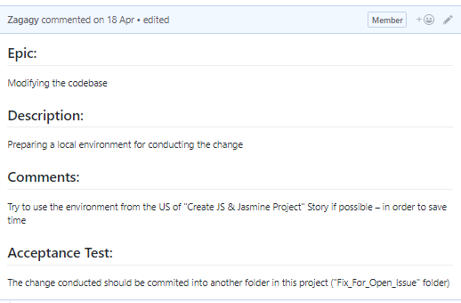
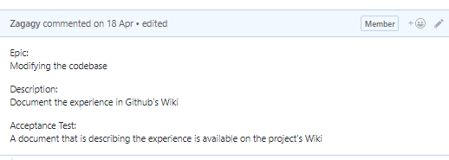
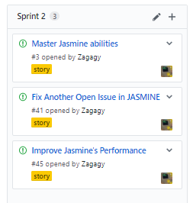
Software Engineering #22916 , Project by Ben Zagagy (300924859)
Sprint #1 Content:
8. Fix the Open Issue
9. Document the experience
Sprint #2 Content:
✔
Project Overview
Introduction and motivation
Planning
Execution (Development)
Results
Conclusions
✔

Slide 10
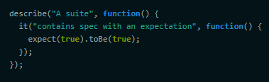
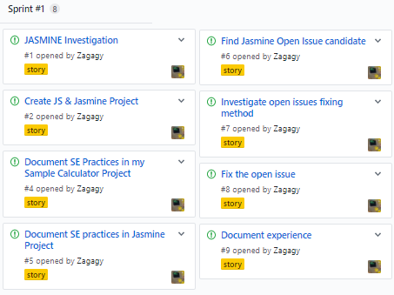
Software Engineering #22916 , Project by Ben Zagagy (300924859)
Execution:
US #1 - JASMINE Investigation
Jasmine basic structure:
Suites:
A test suite begins with a call to the global Jasmine function describe with two parameters: a string and a function.
The string is a name or title for a spec suite - usually what is being tested.
The function is a block of code that implements the suite.
Specs:
Specs are defined by calling the global Jasmine function it,
which, like describe takes a string and a function. The string is the title of the spec and the function is the spec, or test.
(Since describe and it blocks are functions, they can contain any executable code necessary to implement the test)
✔
Project Overview
Introduction and motivation
Planning
Execution (Development)
Results
Conclusions
✔
✔

Slide 11
Software Engineering #22916 , Project by Ben Zagagy (300924859)
Execution:
US #1 - JASMINE Investigation
Jasmine basic structure:
Expectations & Matchers:
Expectations are built with the function expect which takes a value called the actual.
It is chained with a Matcher function, which takes the expected value.
Each matcher implements a boolean comparison between the actual value and the expected value.
Some of Jasmine’s Mathcers are:
to(Not)Be( null | true | false )
to(Not)Equal( value )
to(Not)Match( regex | string )
toBeDefined()
toBeUndefined()
toBeNull()
toBeTruthy()
toBeFalsy()
to(Not)Contain( string )
✔
Project Overview
Introduction and motivation
Planning
Execution (Development)
Results
Conclusions
✔
✔

Slide 12
Software Engineering #22916 , Project by Ben Zagagy (300924859)
Execution:
US #2 – Create JS & Jasmine Project
This Project contains a sample Calculator written in pure JS.
Its main goal is to use JASMINE TDDs Framework and to be able to analyze and investigate Software Engineering practices performed in it.
✔
Project Overview
Introduction and motivation
Planning
Execution (Development)
Results
Conclusions
✔
✔
✔

Slide 13
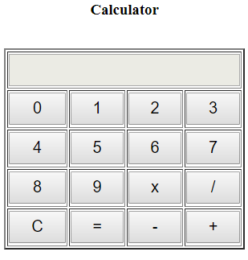
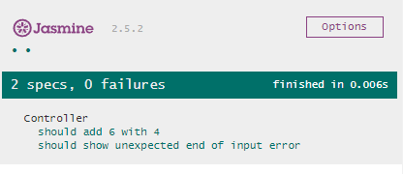
Software Engineering #22916 , Project by Ben Zagagy (300924859)
Execution:
US #2 – Create JS & Jasmine Project
The Simple Calculator Code can be found at:
https://cdn.rawgit.com/Zagagy/CalculatorJasmine/43b249dd/index.html
Some custom Jasmine’s Specs Running and testing this JS can be found at:
https://cdn.rawgit.com/Zagagy/CalculatorJasmine/43b249dd/jasmine/SpecRunner.html
✔
Project Overview
Introduction and motivation
Planning
Execution (Development)
Results
Conclusions
✔
✔
✔

Slide 14
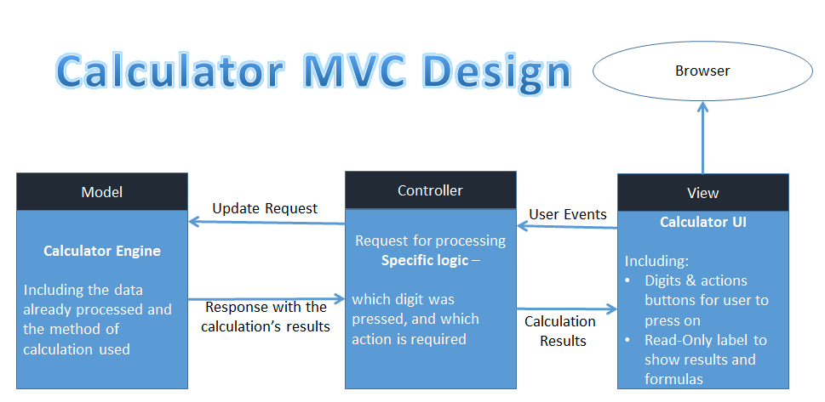
Software Engineering #22916 , Project by Ben Zagagy (300924859)
Execution:
US #3 – SE Practices in Calculator Project
Reuse-oriented software engineering
The system is assembled from existing components –
I have used an existing base project for the UI and styles, taken from: http://www.siteforinfotech.com/2015/02/how-to-create-simple-calculator-using.html
MVC pattern
I have changed the engine to work in an MVC Pattern
✔
Project Overview
Introduction and motivation
Planning
Execution (Development)
Results
Conclusions
✔
✔
✔
✔

Slide 15
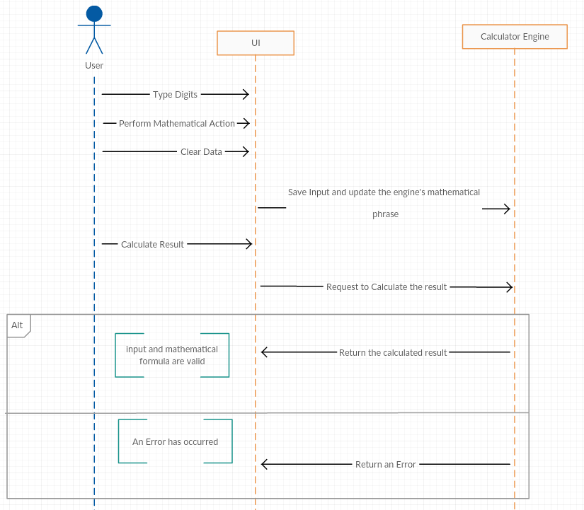
Software Engineering #22916 , Project by Ben Zagagy (300924859)
Execution:
US #3 – SE Practices in Calculator Project
Tests Driven Development
I have created a few Jasmine TDDs prior to my coding,
the TDDs first verified valid input and outputs.
The TDDs also verified that invalid input and output are returning errors.
Sequence Diagram
I have created a Sequence Diagram In order to have better understanding of my application's flow and usage methods
✔
Project Overview
Introduction and motivation
Planning
Execution (Development)
Results
Conclusions
✔
✔
✔
✔

Slide 16
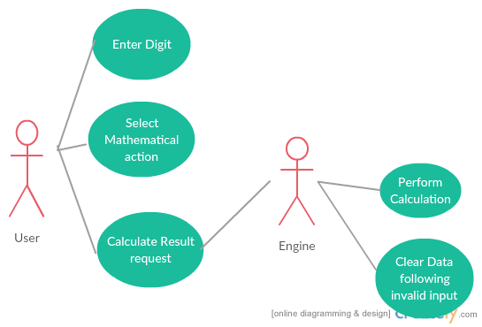
Software Engineering #22916 , Project by Ben Zagagy (300924859)
Execution:
US #3 – SE Practices in Calculator Project
Use Case Diagram
In order to have better understanding of my application's abilities and flows, I have created a Use Case Diagram to guide me through the development process
Other SE Practices used in this project:
The Project’s Code is located in Github – Version Control System usage.
Use Backlog for the tasks ahead
Divide those tasks into User Stories
Assign the US onto different sprints.
✔
Project Overview
Introduction and motivation
Planning
Execution (Development)
Results
Conclusions
✔
✔
✔
✔

Slide 17
Software Engineering #22916 , Project by Ben Zagagy (300924859)
Execution:
US #4 – SE Practices in Jasmine
TDDs
The project's main purpose is to give TDD abilities to JS Developers
Version Control System
the Entire JASMINE Project is saved and handled using GitHub
Reuse
reuses multiple existing technologies from the web and JS world (node JS, Ruby etc.)
Backlog for Raised issues
Can be found at: https://github.com/jasmine/jasmine/issues
Backlog for future releases
Can be found at: https://www.pivotaltracker.com/n/projects/10606
Use of Iterations(Sprints) of a week
Can be found at: https://www.pivotaltracker.com/reports/v2/projects/10606/iterations/current
✔
Project Overview
Introduction and motivation
Planning
Execution (Development)
Results
Conclusions
✔
✔
✔
✔
✔

Slide 18
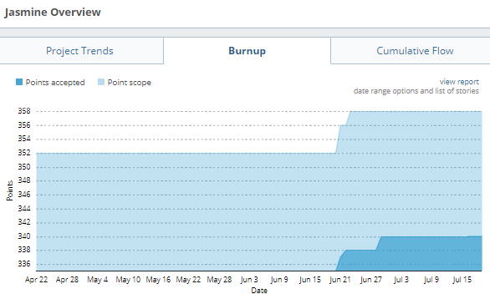
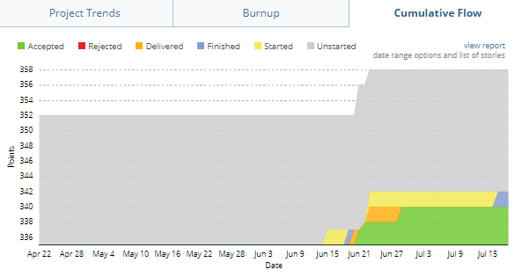
Software Engineering #22916 , Project by Ben Zagagy (300924859)
Execution:
US #4 – SE Practices in Jasmine
Burn-up Chart
Shows how much work has been completed, and the total amount of work, can be found at:
https://www.pivotaltracker.com/reports/v2/projects/10606/overview?selected_tab=burnup
Cumulative Flow Chart
Allows the team to visualize their effort and the project progress, can be found at:
https://www.pivotaltracker.com/reports/v2/projects/10606/overview?selected_tab=burnup
✔
Project Overview
Introduction and motivation
Planning
Execution (Development)
Results
Conclusions
✔
✔
✔
✔
✔

Slide 19
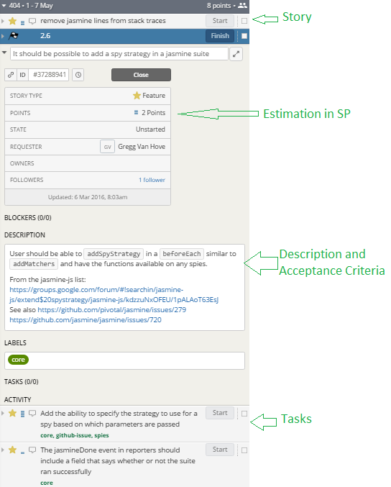
Software Engineering #22916 , Project by Ben Zagagy (300924859)
Execution:
US #4 – SE Practices in Jasmine
Story Points, Acceptance Criteria, Tasks and US within each iteration
✔
Project Overview
Introduction and motivation
Planning
Execution (Development)
Results
Conclusions
✔
✔
✔
✔
✔

Slide 20
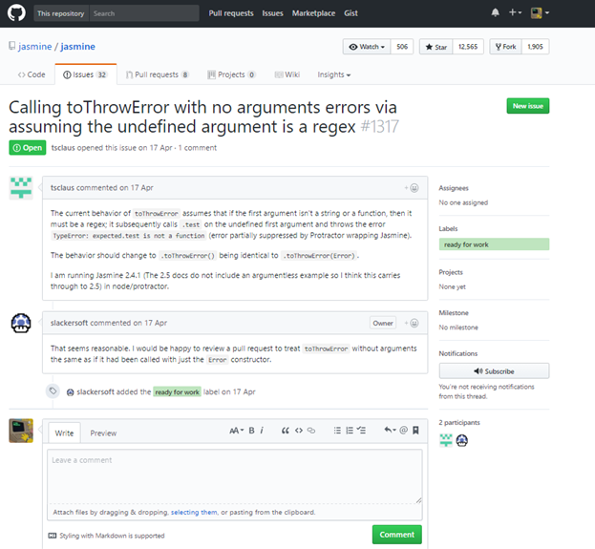
Software Engineering #22916 , Project by Ben Zagagy (300924859)
Execution:
US #5 & 6 – Find Jasmine Open Issues Candidate and investigate it.
Jasmine open issues list can be found at:
https://github.com/jasmine/jasmine/issues
I was impressed as for a framework with tens of thousands of users, to have such a low amount of 32 open issues is really admirable.
I have found the following issue(#1317),I believe that using my abilities and experience I will be able to fix in a quick and efficient way.
The issue is basically saying that there is a need for the “toThrowError” function to be used without any arguments (in other words - to overload it with an empty implementation)
✔
Project Overview
Introduction and motivation
Planning
Execution (Development)
Results
Conclusions
✔
✔
✔
✔
✔
✔

Slide 21
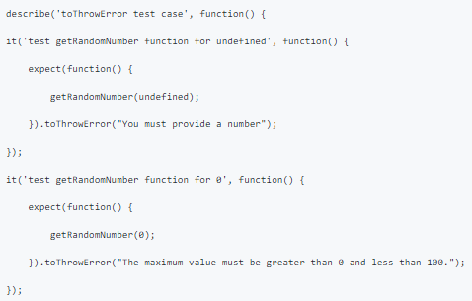
Software Engineering #22916 , Project by Ben Zagagy (300924859)
Execution:
US #7 – Fix the Open Issue:
I have looked for usages for the “toThrowError” function in Google, I have came to the following StackOverflow Page
https://stackoverflow.com/questions/21221697/using-tothrowerror-in-jasmine
The “toThrowError” function is used to catch js thrown errors using jasmine
toThrowError matcher takes 1 or 2 parameters
1 Parameter - Either exception message or exception type
2 Parameters - Exception type and Exception message
✔
Project Overview
Introduction and motivation
Planning
Execution (Development)
Results
Conclusions
✔
✔
✔
✔
✔
✔
✔
✔

Slide 22
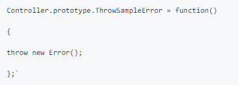
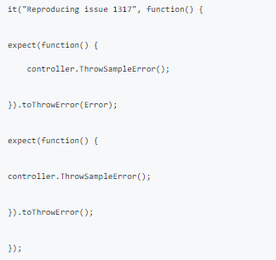
Software Engineering #22916 , Project by Ben Zagagy (300924859)
Execution:
US #7 – Fix the Open Issue:
I will now reproduce this issue using the Jasmine calculator application that I have created.
In my sample project, I have added a new button that throws an Error.
I will use the Jasmine Project I had to call it as follows:
✔
Project Overview
Introduction and motivation
Planning
Execution (Development)
Results
Conclusions
✔
✔
✔
✔
✔
✔
✔
✔

Slide 23
Software Engineering #22916 , Project by Ben Zagagy (300924859)
Execution:
US #7 – Fix the Open Issue:
I will now reproduce this issue using the Jasmine calculator application that I have created.
In my sample project, I have added a new button that throws an Error.
I will use the Jasmine Project I had to call it as follows:
✔
Project Overview
Introduction and motivation
Planning
Execution (Development)
Results
Conclusions
✔
✔
✔
✔
✔
✔
✔
✔
The idea behind this test case is that if the bug issue wasn’t happening, both expect sections should return the same result

Slide 24
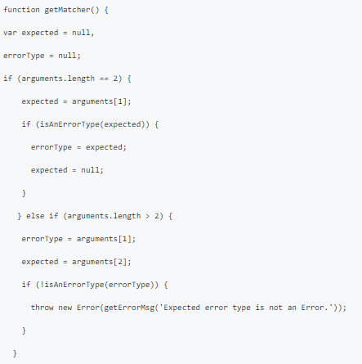
Software Engineering #22916 , Project by Ben Zagagy (300924859)
Execution:
US #7 – Fix the Open Issue:
When using this function I get the following error message for the second function(the one that was called without an argument):
"Expected function not to throw an Error, but it threw Error."
In Jasmine’s Core Code:
Jasmine error checking function called “getMatcher()" has the following if statements:
✔
Project Overview
Introduction and motivation
Planning
Execution (Development)
Results
Conclusions
✔
✔
As we can see –
this code doesn’t handle
arguments list of the size 1
✔
✔
✔
✔
We can also see that the first argument is always the expected error type
✔
✔

Slide 25
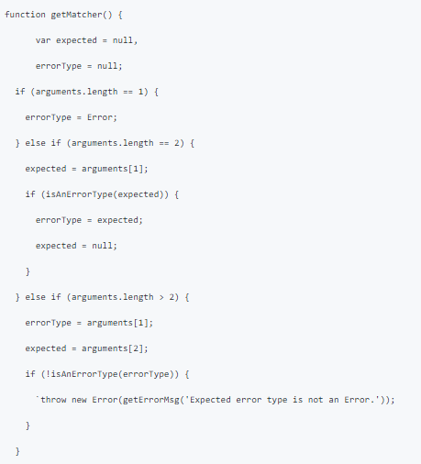
Software Engineering #22916 , Project by Ben Zagagy (300924859)
Execution:
US #7 – Fix the Open Issue:
My plan is to add another case for the getMatcher function, This case will handle arguments list of size 1.
✔
Project Overview
Introduction and motivation
Planning
Execution (Development)
Results
Conclusions
✔
✔
As expected this small change fixed the issue.
If it was my code-base I would have fixed this issue differently.
I would rather use a switch statement instead of the 3 different “if” statements… but:
I have tried to have a fix with as small amount of lines as possible (to increase my fix’s chances to be merged to Jasmine’s Master)
I have seen through the entire code in Jasmine’s source that multiple “if else” statements are used
✔
✔
✔
✔
✔
✔

Slide 26
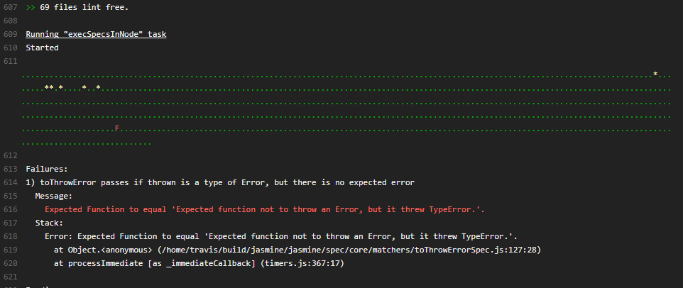
Software Engineering #22916 , Project by Ben Zagagy (300924859)
Execution:
US #7 – Fix the Open Issue:
Preparing a local environment for conducting the change
I have cloned the Jasmine Repository to my local environment.
I have set my change in to the correct location of the getMatcher() function, located at:
jasmine/src/core/matchers/toThrowError.js
Pushing my Fix
I have tried to push my fix according to the following instructions:
https://github.com/jasmine/jasmine/blob/master/.github/CONTRIBUTING.md
I received a “Permission denied” answer (it was On the 23.6.17)
Following the Permission denied answer, I have contacted Jasmine’s repository owner in order to receive the correct permissions in order to proceed.
At the 15.7.17 I have received those permissions and tried to generate a “pull request” for my changes
My first try failed , I didn’t run any of Jasmine’s TDDs prior to my pull request and build, ironically failed on TDDs for TDDs framework ☺
✔
Project Overview
Introduction and motivation
Planning
Execution (Development)
Results
Conclusions
✔
✔
✔
✔
✔
✔
✔
✔

Slide 27
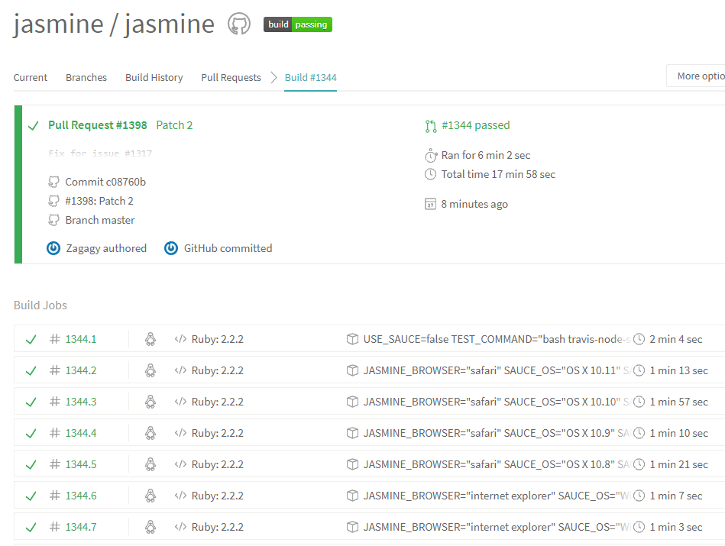
Software Engineering #22916 , Project by Ben Zagagy (300924859)
Execution:
US #7 – Fix the Open Issue:
Pushing my Fix
I have found the co-responding test-case and updated it
My second pull request and build were much more successful as can be seen at:
https://travis-ci.org/jasmine/jasmine/builds/253916250?utm_source=github_status&utm_medium=notification
✔
Project Overview
Introduction and motivation
Planning
Execution (Development)
Results
Conclusions
✔
✔
✔
✔
✔
✔
✔
✔
now all that is left for me to do is to wait and see if and when will my fix be pushed to Jasmine's Master Repository.
(The documenting of this experience as part of US #8 can be found at the Wiki page of my project)

Slide 28
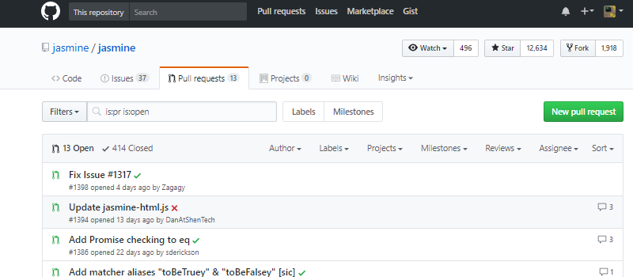
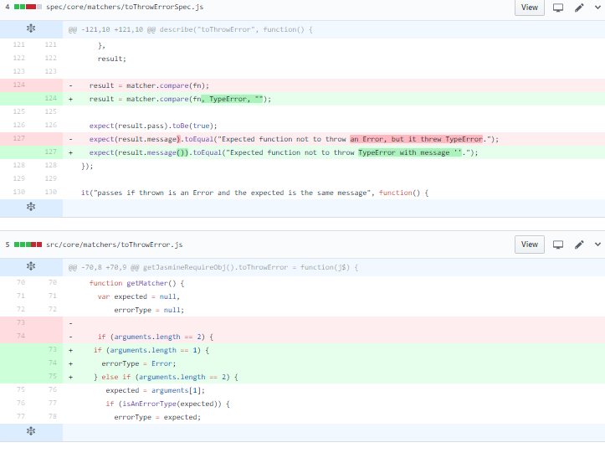
Software Engineering #22916 , Project by Ben Zagagy (300924859)
Results:
My Pull Request contains 2 files that contains the fix for issue #1317 within Jasmine framework’s Repository.
✔
Project Overview
Introduction and motivation
Planning
Execution (Development)
Results
Conclusions
✔
✔
✔

Slide 29
Software Engineering #22916 , Project by Ben Zagagy (300924859)
Conclusions:
As a Developer I must say that this Project helped me with couple of areas that I always wanted to experience but didn’t have the time/motivation to.
This Project helped me master Github’s framework and terminology.
This Project helped me master Jasmine’s functionality, flow and core code structure.
This Project gave me the opportunity to help and support one of the most helpful and useful open source frameworks I have worked with.
It was my first time helping and support an open-code source, hopefully not the last.
As my team’s SCRUM Master, I feel that this course and project gave me new tools to use and practice in my workplace (TRACXPOiNT)
Up until today, our Jasmine’s tests were only connected to our Jenkins build system.
I have started to share my knowledge and experience with Jasmine in order for our team to be able to use Jasmine’s TDDs during real-time development .
I believe that identifying critical issues using this working methodology could save our team critical time and money in our upcoming projects.
✔
Project Overview
Introduction and motivation
Planning
Execution (Development)
Results
Conclusions
✔
✔
✔
✔

Slide 30
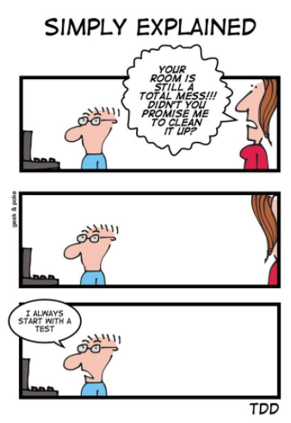
Software Engineering #22916 , Project by Ben Zagagy (300924859)
✔
Project Overview
Introduction and motivation
Planning
Execution (Development)
Results
Conclusions
✔
✔
✔
✔
✔

